Slide 1
“Bayesian SDT modeling” “Bayesian Cognitive modeling applied to a SDT task: the Mirror Effect meets individual cognitive modeling, contaminant analysis and step point change”
These are just some ideas for a good title…

Slide 2
Disclaimer:
This presentation was made as a tool to “put things together” and begin to fix/set the “story” or the “main course” that I’m planning to cover with my SDT study/paper/presentation.
It’s meant to present, step by step what’s planned to be done and the main findings/plots/estimations to report as a result of each step.
Also, this could be consider a draw for any Talk or presentation derived from this research project.

Slide 3
1. Making sure d’(A) > d’(B)
In order to make our results comparable to what has been reported on the literature of the Mirror Effect withing Recognition Memory, we have to be able to guarantee that our two clases of stimuli are indeed different in terms of how “difficult” they are.

Slide 4
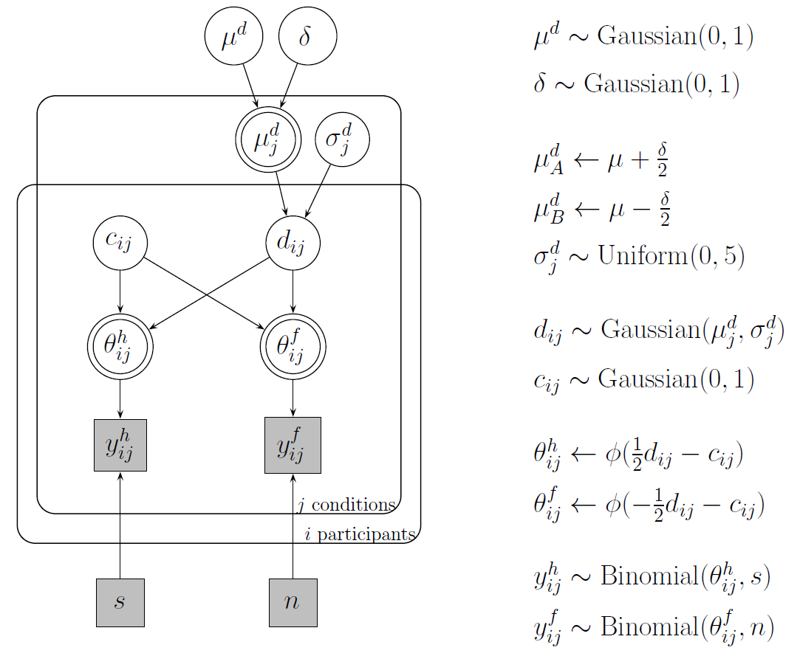

Slide 5
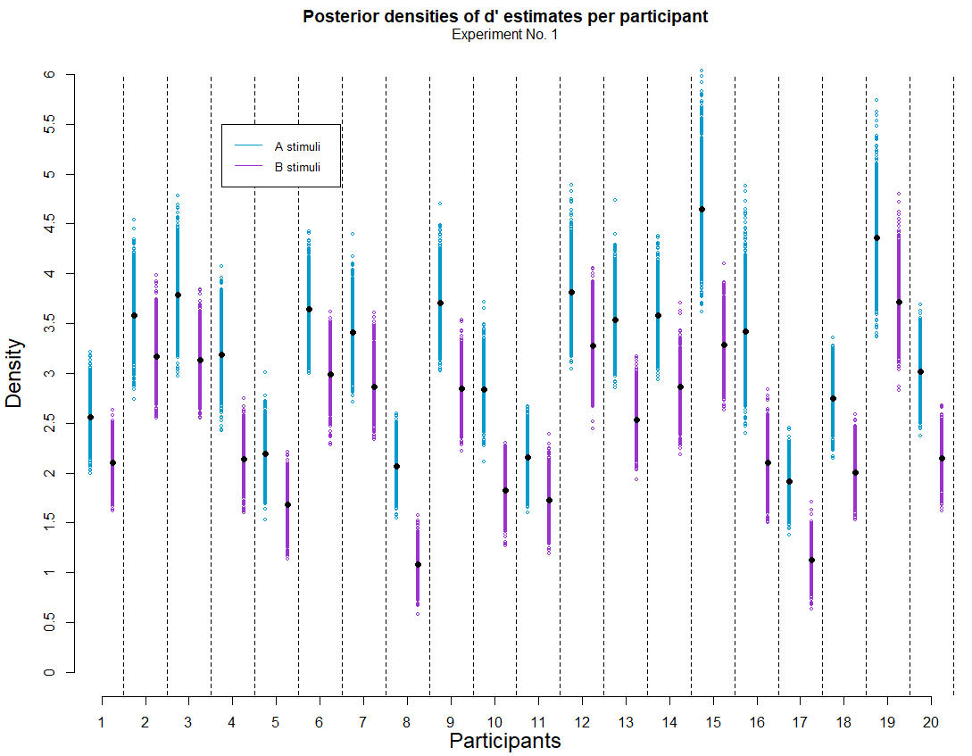
Plot 1
What’s important about this plot?
For all participants, d’ estimates are greater for A class stimuli than for B class.
Notes:
PS: Alex suggested me to use this kind of plot and I really liked it.

Slide 6
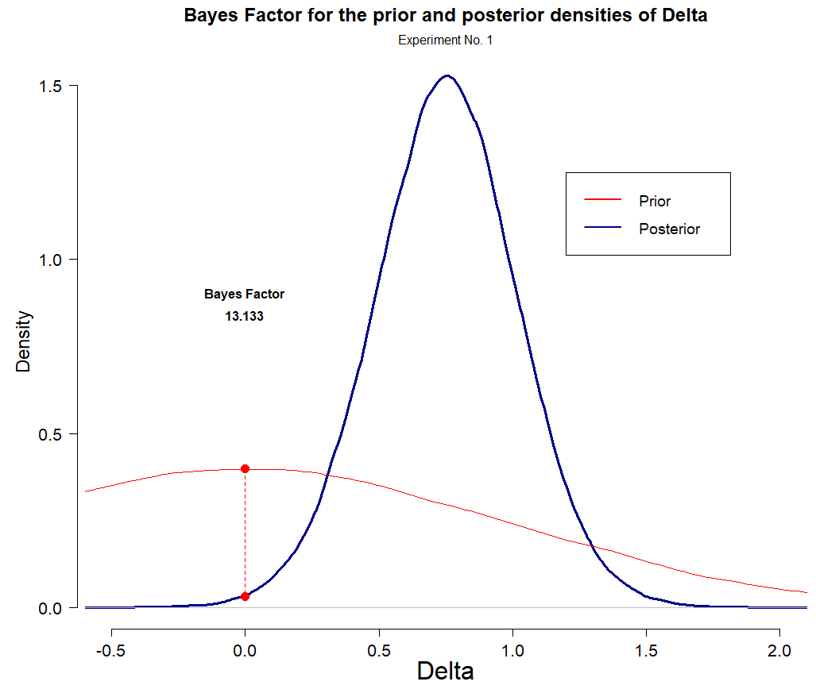
Plot 2
What’s important about this plot?
According to the Bayes Factor, the posterior estimates suggest that it’s 13 times lees likely that the difference between d’ across each class of stimuli is 0, than/from what had been stated on the prior.
Notes:
PS: Alex suggested me to use this kind of plot and I really liked it.

Slide 7
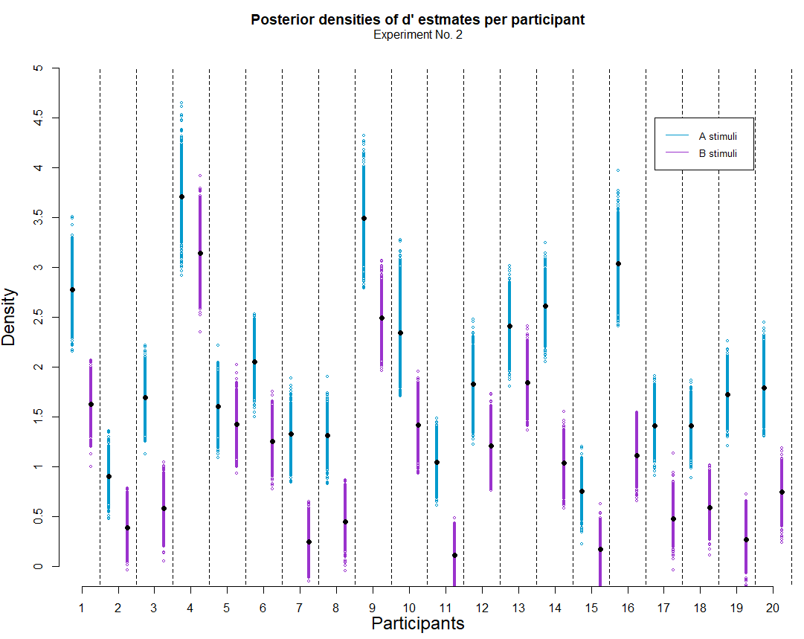
Plot 1
Same things happen in Experiment 2
For all participants, d’ estimates are greater for A class stimuli than for B class.
Notes:
PS: Alex suggested me to use this kind of plot and I really liked it.

Slide 8
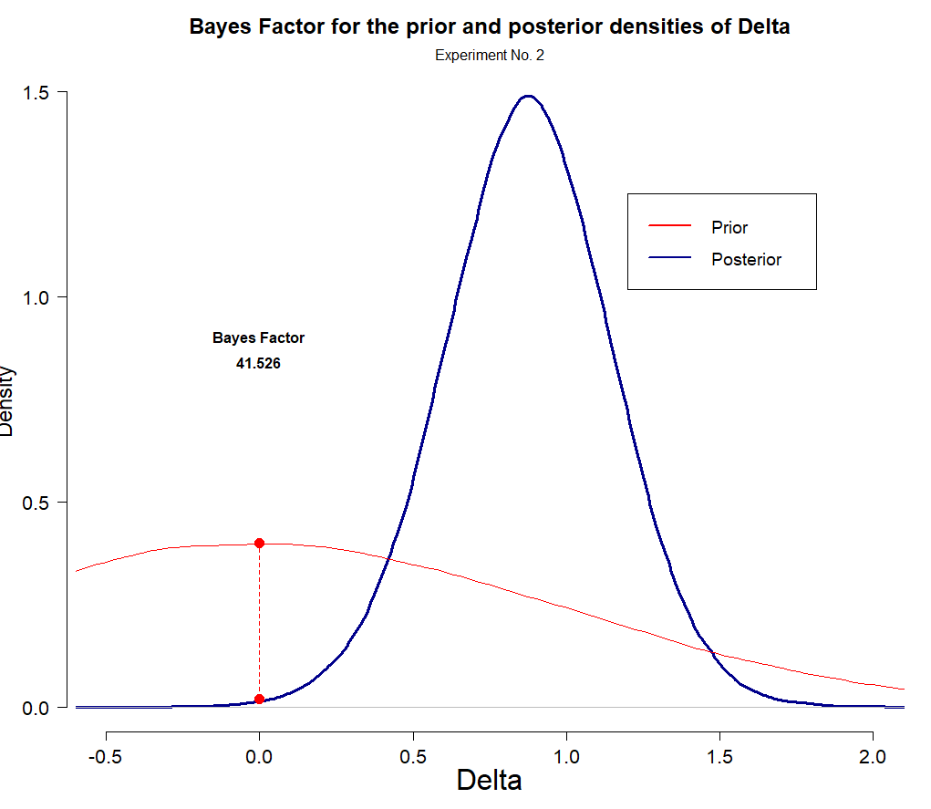
Plot 2
According to the Bayes Factor, the posterior estimates suggest that it’s 41.5 times lees likely that the difference between d’ across each class of stimuli is 0, than/from what had been stated on the prior.

Slide 9
2. Contaminant Bayesian modeling
PENDING
In order to make our results comparable to what has been reported on the literatura of the Mirror Effect withing Recognition Memory, we have to be able to guarantee that our two clases of stimuli are indeed different in terms of how “difficult” they are.

Slide 10
2.1 A “simple” contaminant model
PENDING
A mixture model based on a

Slide 11
2.1 A “cognitive” contaminant model
PENDING
A Mixture Model

Slide 12
3. Looking for the Mirror Effect
Comparing the Hit and F.A. rates across clases of stimuli to see if we can find the same pattern as the one reported in the literatura under the name of “the Mirror Effect”
FA(A) < FA(B) < H(B) < H(A)

Slide 13
3.1 Comparing binomial response rates

Slide 14
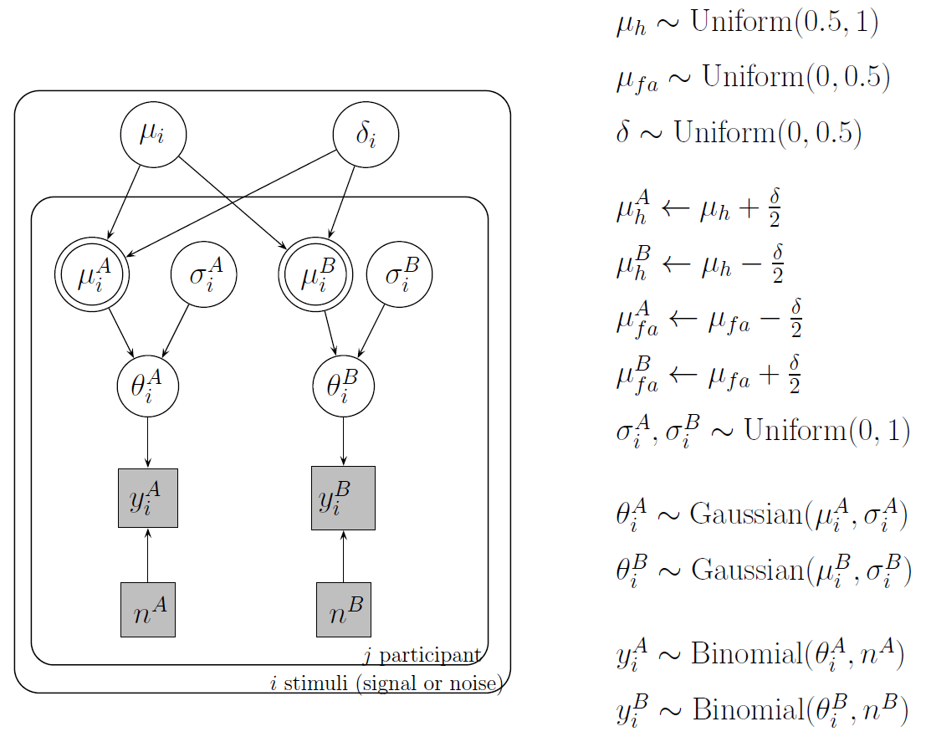

Slide 15
3.2 Comparing Hit rates and F.A. rates in the context of a Bayesian cognitive model
Using a Bayesian cognitive SDT model to look through the differences observed between the Hit and F.A. rates across clases of stimuli

Slide 16
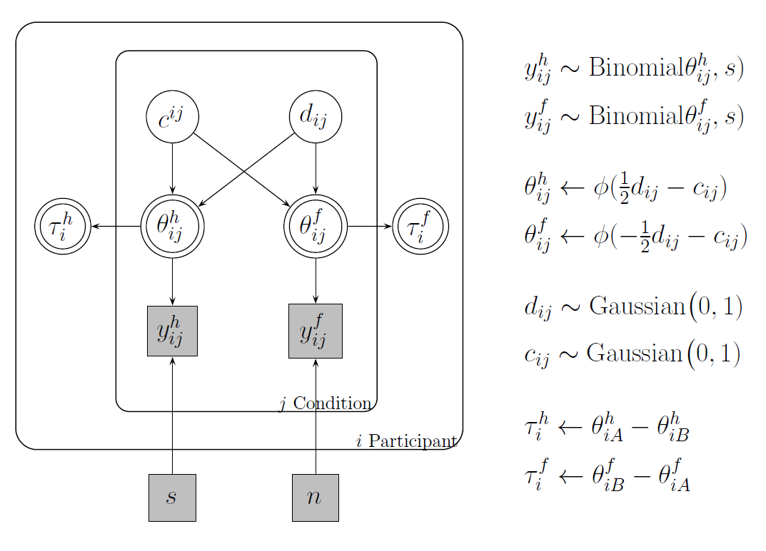

Slide 17
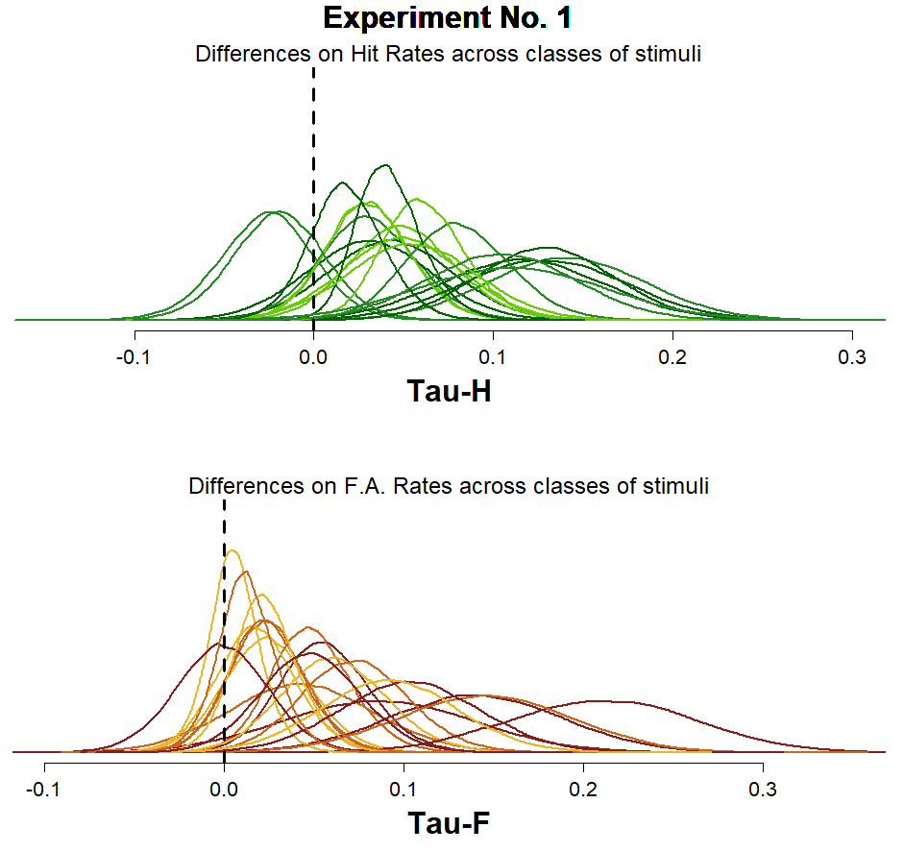
Plot 1
Based on the individual Tau-H and Tau-F posterior distributions being shown, it’s clear that there’s a lot of variability (even if “at first glance” one might be tempted to say that the majority of the posterior density lies to the right side of the “0 differences between classes” point).

Slide 18
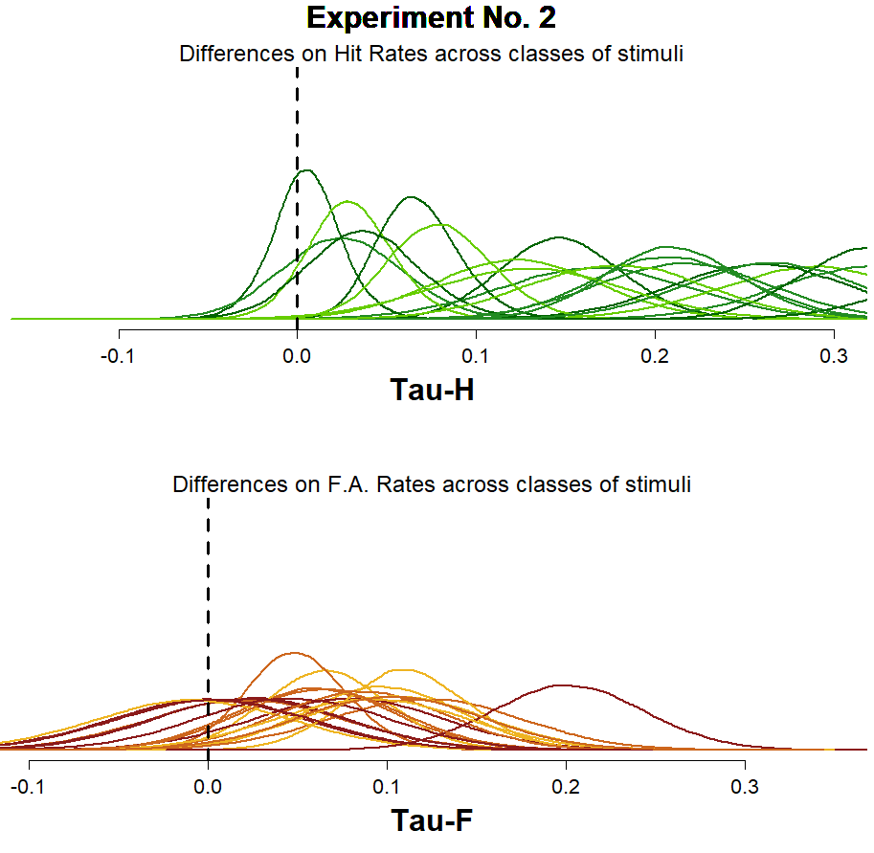
Plot 1
For Experiment 2, you can see that the estimates for the differences between the Hit Rates has clearly increased, at the same time that the estimates made for the differences between the FA rates seem to be a Little bit more clustered around 0.

Slide 19
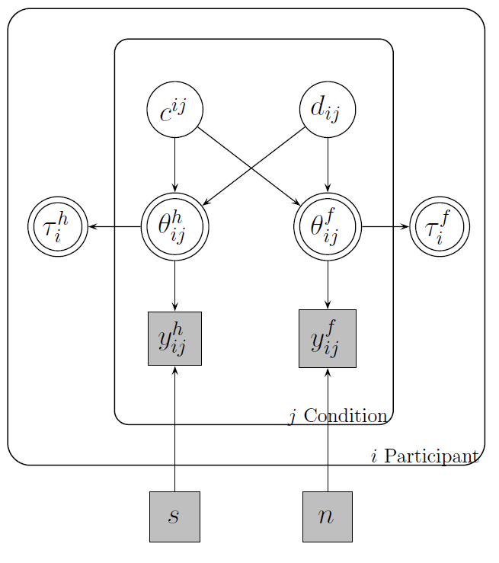

Given that this particular model was constructed so that both Taus are deterministically estimated, based on the indiviual estimations made for $θ_{ij}^{H}$ and $θ_{ij}^{F}$, conducting a Bayes Factor or any other density ratio measure might not seem like a straight-forward thing to do.

Slide 20

Given that this particular model was constructed so that both Taus are deterministically estimated, based on the indiviual estimations made for $θ_{ij}^{H}$ and $θ_{ij}^{F}$, conducting a Bayes Factor or any other density ratio measure might not seem like a straight-forward thing to do.
It is under this disclaimer that we conducted a Bayes Factor for every individual Tau taking as a reference the following, not stated in the model, “prior distribution”:
$$prior({Tau}_{i}^{j} \sim Normal(0,0.2)$$

Slide 21
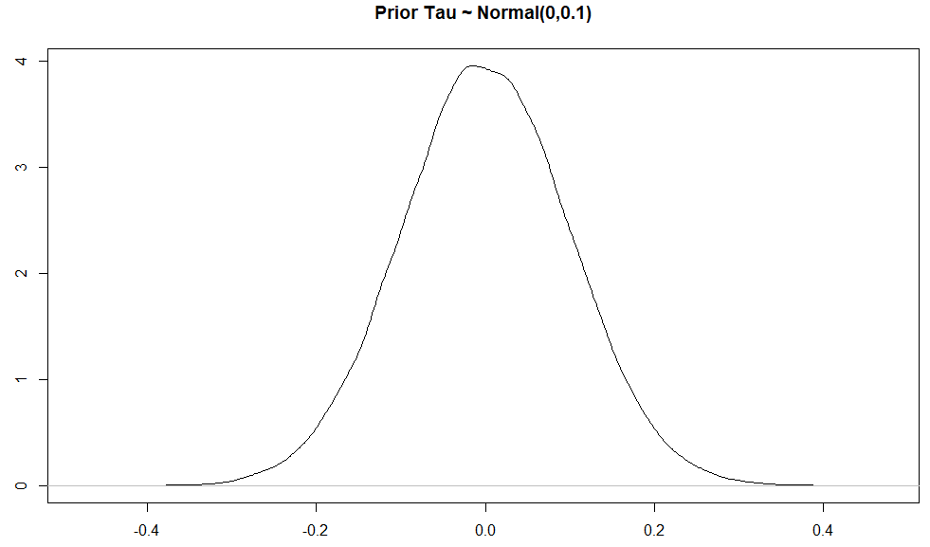
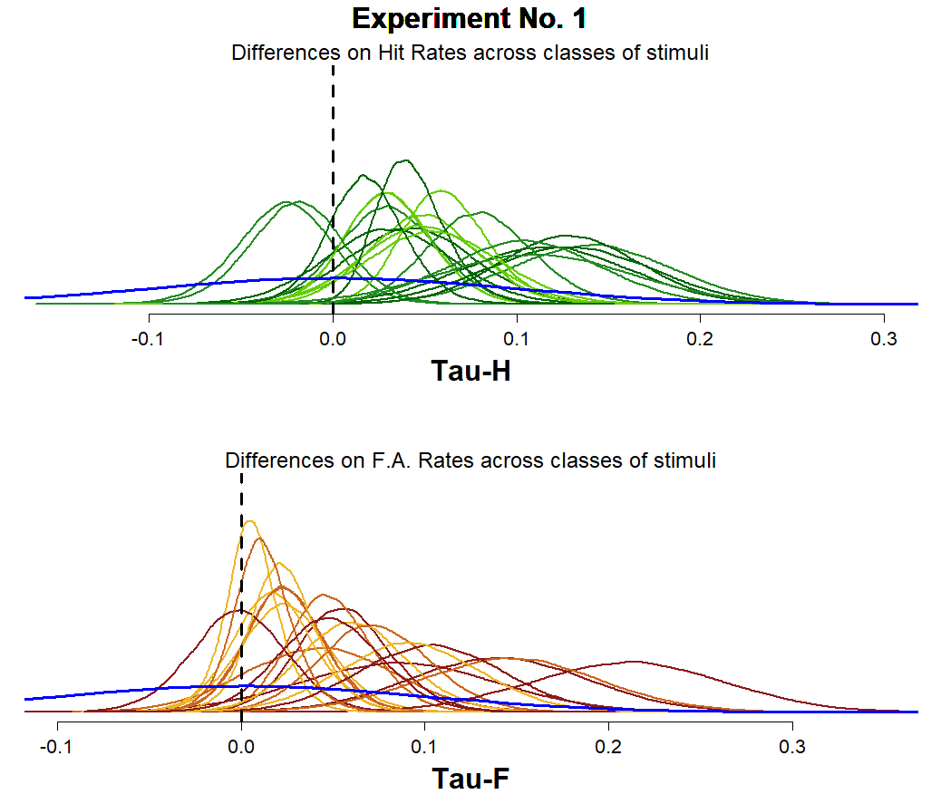

Given that this particular model was constructed so that both Taus are deterministically estimated, based on the indiviual estimations made for $θ_{ij}^{H}$ and $θ_{ij}^{F}$, conducting a Bayes Factor or any other density ratio measure might not seem like a straight-forward thing to do.
It is under this disclaimer that we conducted a Bayes Factor for every individual Tau taking as a reference the following, not stated in the model, “prior distribution”:
$$prior({Tau}_{i}^{j} \sim Normal(0,0.1)$$

Slide 22
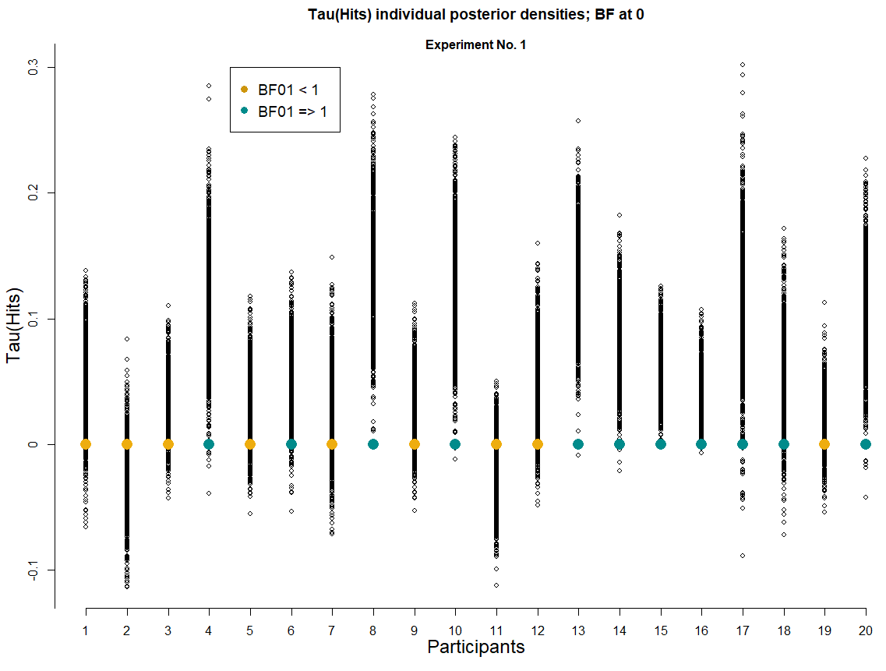
Plot 1
We can see that for Experiment No. 1, there are 9 participants (Golden color) who show a greater posterior desity at the 0 difference point between the Hit rates for each class of stimuli, compared to the artificial prior distribution proposed for reference.

Slide 23
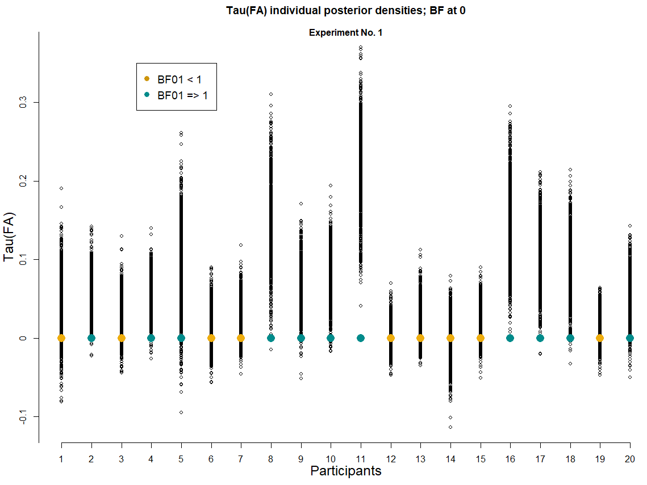
Plot 1
We can see that for Experiment No. 1, there are 9 participants (Golden color) who show a greater posterior desity at the 0 difference point between the False Alarms rates for each class of stimuli, compared to the artificial prior distribution proposed for reference.

Slide 24
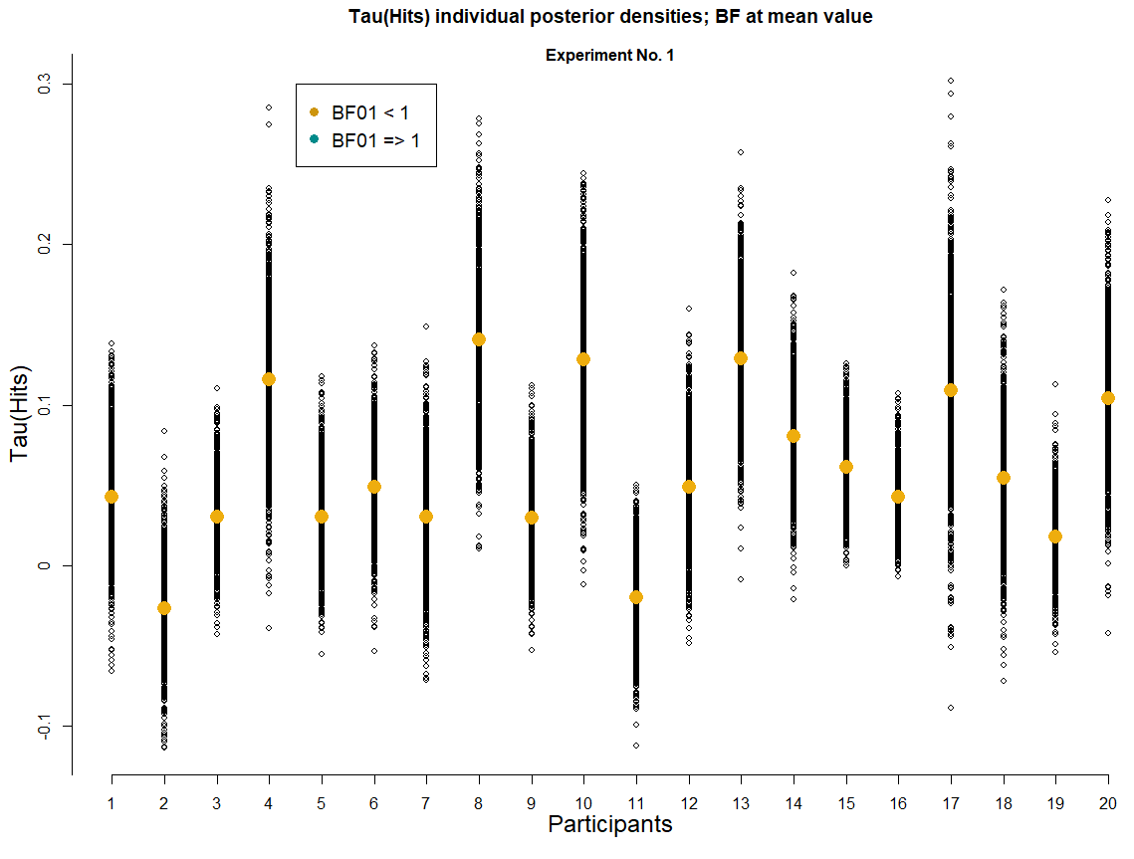
Plot 2
We can see that for Experiment No. 1, all participants had a greater posterior density at their mean value than the prior at this very same point.
I have doubts on whether or not this makes sense, please see the next slide for the details…

Slide 25
Plot 2
We can see that for Experiment No. 1, all participants had a greater posterior density at their mean value than the prior at this very same point.
Does this comparison even make sense? I mean, it’s pretty clear that no matter what the posterior distribution looks like… its mean is always going to have a greater density than the artificial prior

Slide 26
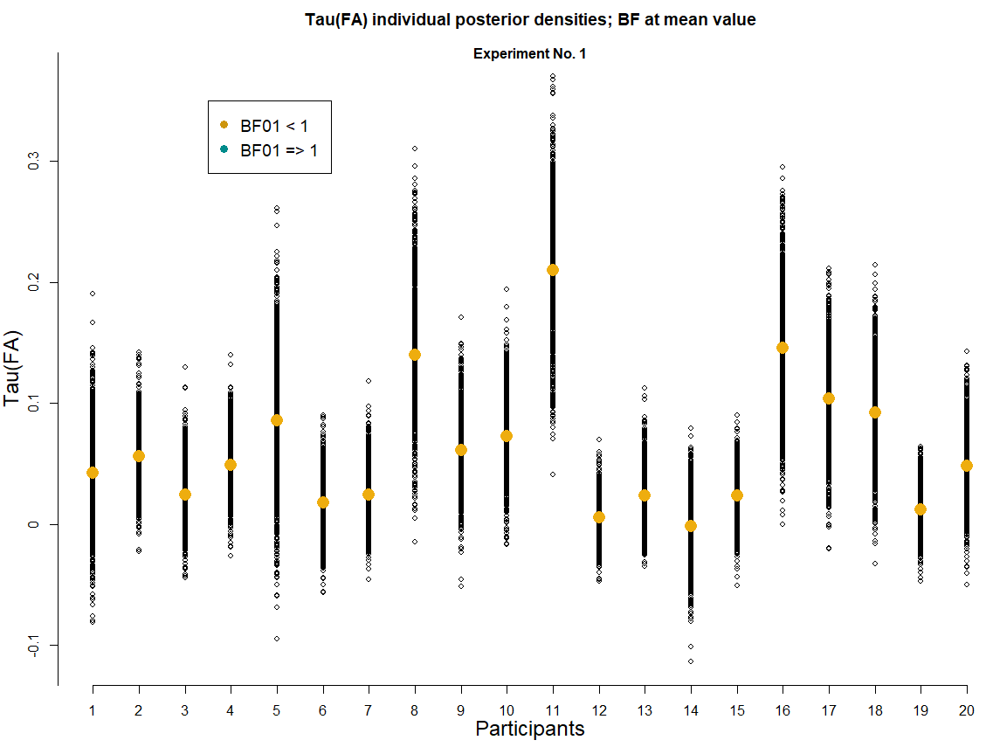
Plot 2
Same thing happens for the differences between the False Alarm rates from each class of stimuli and its Bayes Factor.
Same question as before, of course…

Slide 27
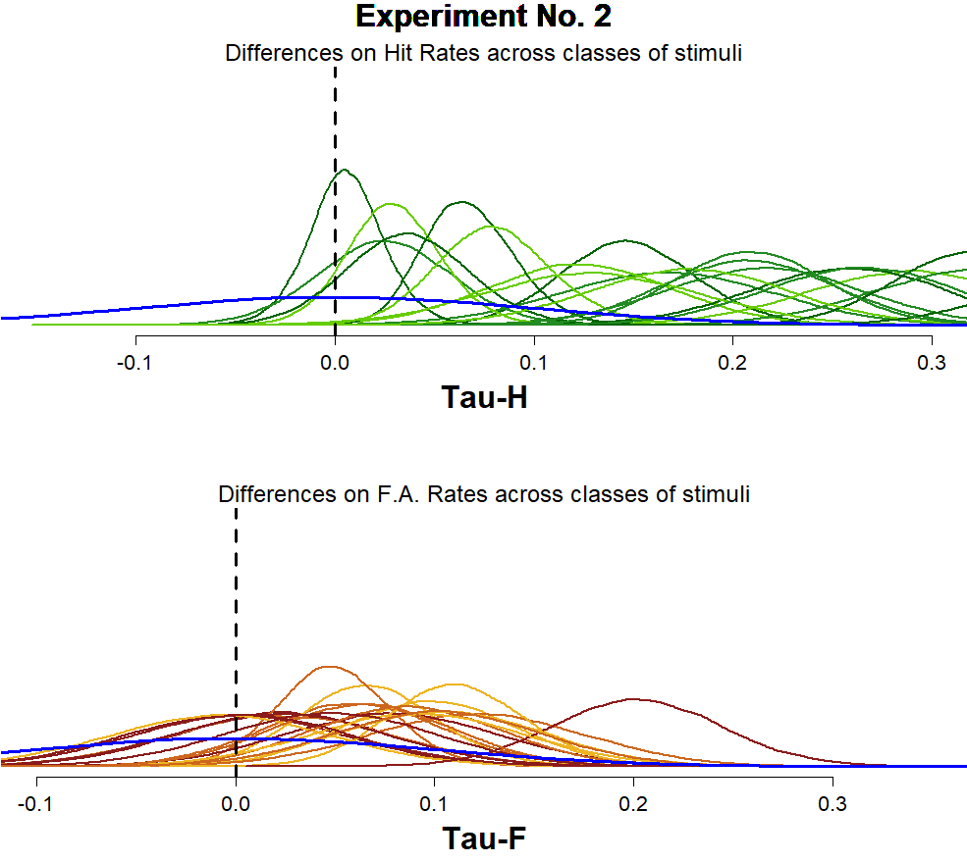
Given that this particular model was constructed so that both Taus are deterministically estimated, based on the indiviual estimations made for $θ_{ij}^{H}$ and $θ_{ij}^{F}$, conducting a Bayes Factor or any other density ratio measure might not seem like a straight-forward thing to do.
It is under this disclaimer that we conducted a Bayes Factor for every individual Tau taking as a reference the following, not stated in the model, “prior distribution”:
$$prior({Tau}_{i}^{j} \sim Normal(0,0.1)$$

Slide 28
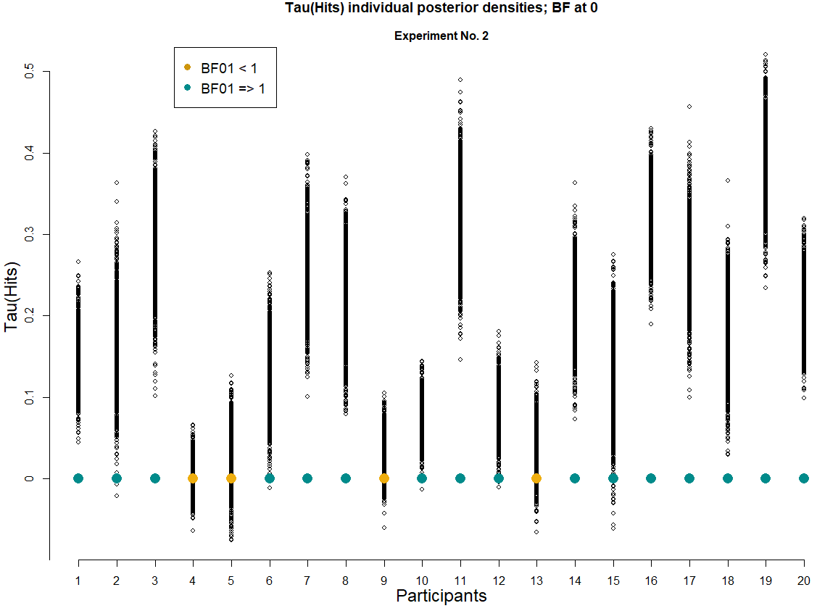
Plot 1
We can see that for Experiment No. 2, there are 4 participants who show a greater posterior density at the point of “0 differences” between the Hit rates of each class of stimuli, compared to the artificial prior.

Slide 29
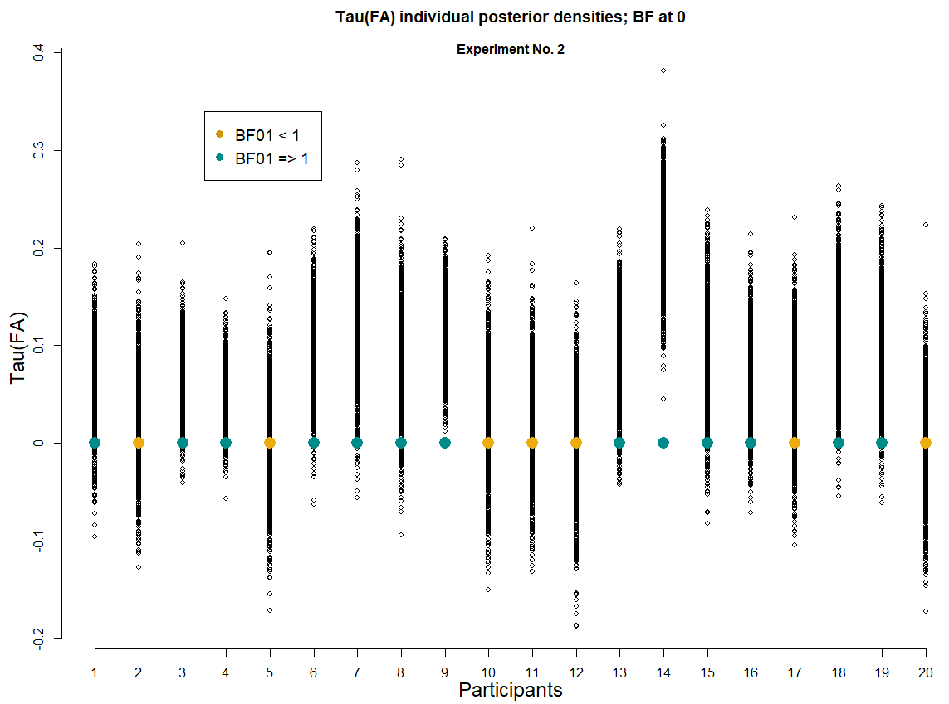
Plot 1
We can see that for Experiment No. 2, there are 7 participants who show a greater posterior density at the point of “0 differences” between the False Alarms rates of each class of stimuli, compared to the artificial prior.

Slide 30
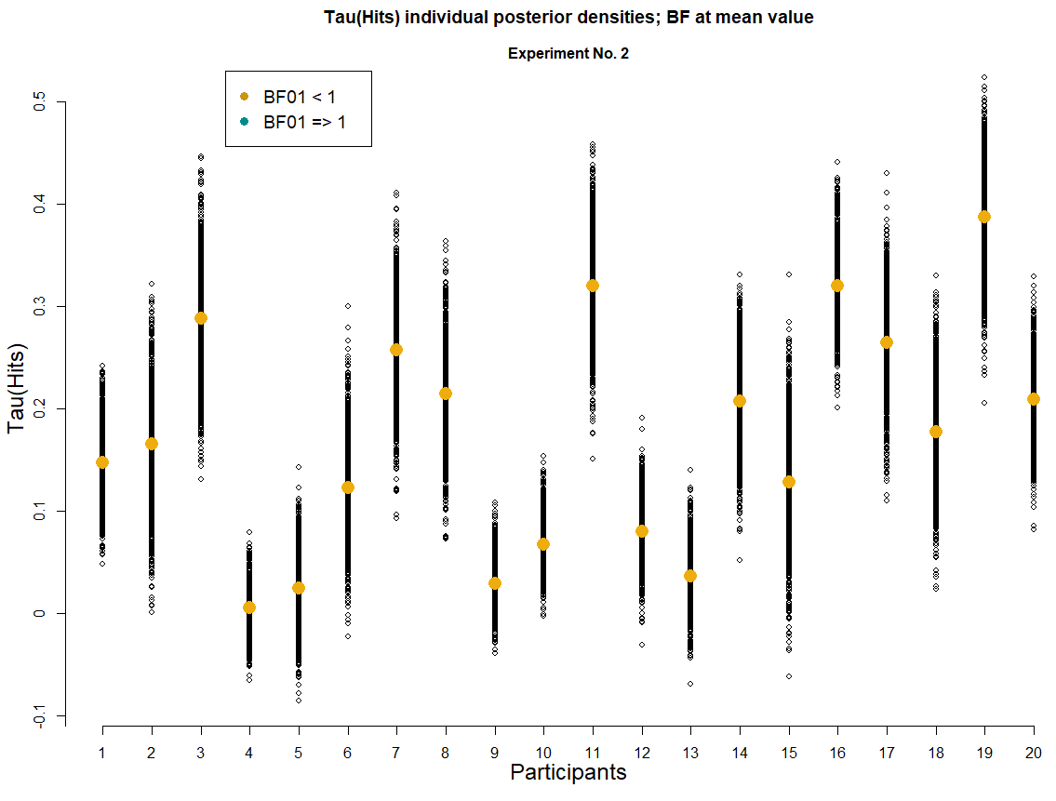
Plot 2
Once again, for the differences between the Hit rates at Experiment No. 2 when we measure the Bayes Factor between the artificial prior and the posterior distributions at the mean value of the posterior, all participants show a greater posterior density tan the prior.
Same question as before, of course…

Slide 31
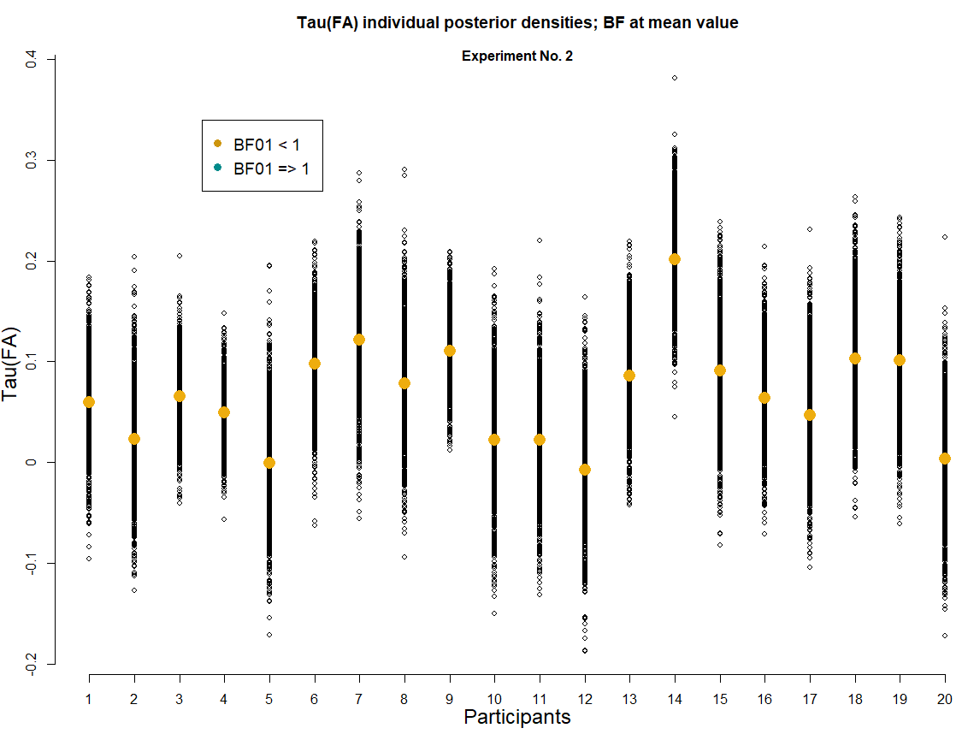
Plot 2
Once again, for the differences between the False Alarms rates at Experiment No. 2 when we measure the Bayes Factor between the artificial prior and the posterior distributions at the mean value of the posterior, all participants show a greater posterior density tan the prior.
Same question as before, of course…

Slide 32
Some sort of conclusion from the past section
Many of the main findings/empirical phenomena reported within Psychology tend to do it in terms of the “mean performance” of all participants.
It is interesting to note that when we conducted a step-by-step replication of the statistical tests that had been reported within the Recognition Memory literature focused on studying the Mirror Effect (t-test with an arcsine comparison of the response rates), we also find “evidence for the Mirror Effect” in our merely perceptual task, (which was itself a very interesting finding in terms of what it suggest about the validity of the models and theories developed to account for the Mirror Effect as a Recognition Memory phenomenom).
However, the presented variation of a Bayesian SDT cognitive model seems to be suggesting that the Mirror Effect could be a phenomena that holds for the “whole group” analysis, but not the individual level.

Slide 33
The present study could serve as a clear reference of the advantages that Bayesian Cognitive modeling has in terms of the general conclusions that can arise from its application, given the great power it has shown to deal with the individual data.
(I’m trying to stay conservative and not take it too far… but this is the general direction that the conclusions arised from this first part would have)

Slide 34
3. Bayesian hierarchical cognitive modeling of our data
Ok, we already know what’s happening in terms of our d’, but, is there any good reason not to look into c estimates as well?

Slide 35
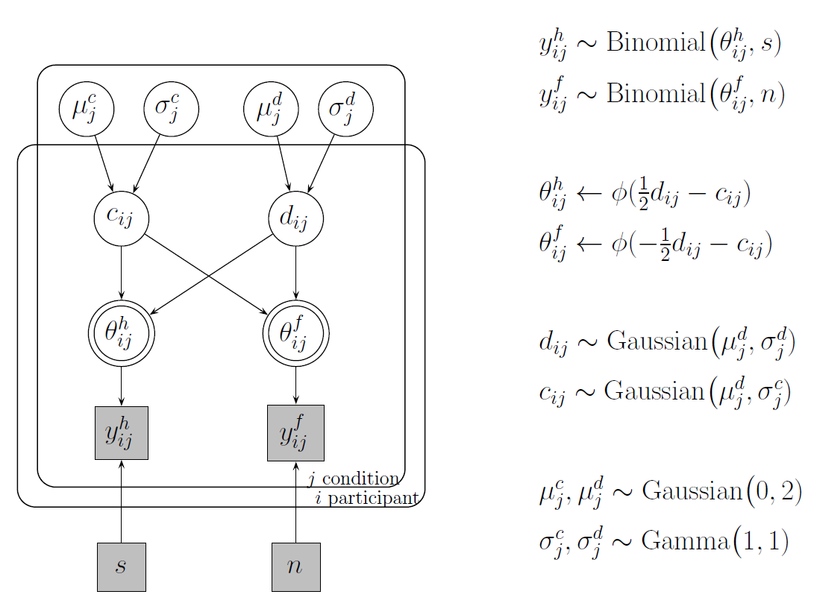

Slide 36
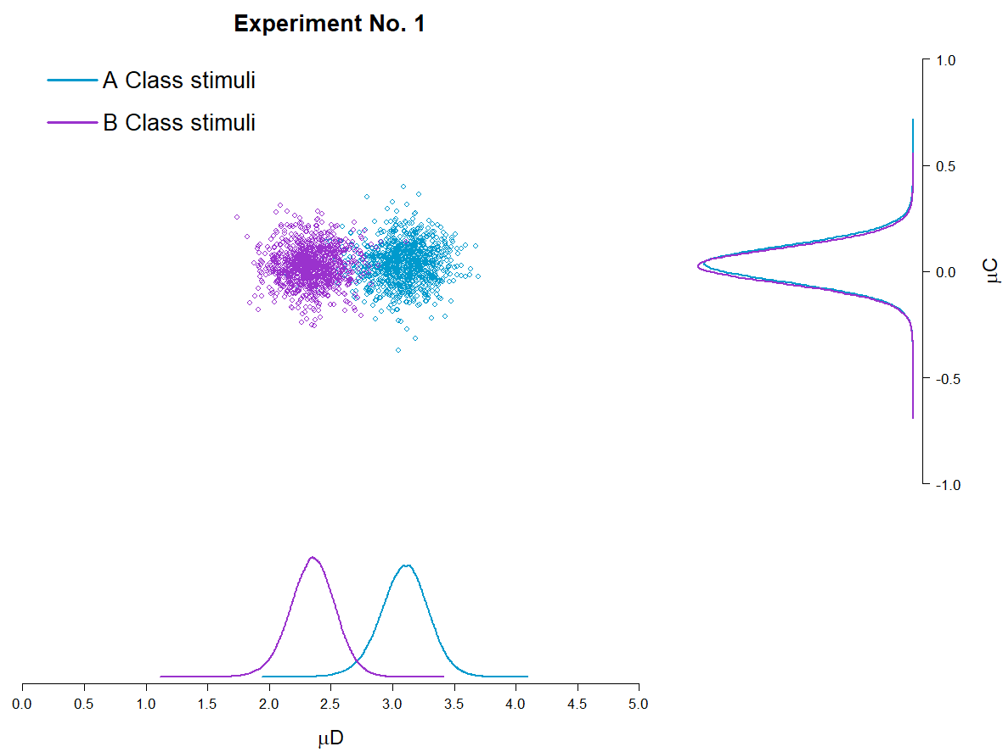

Slide 37
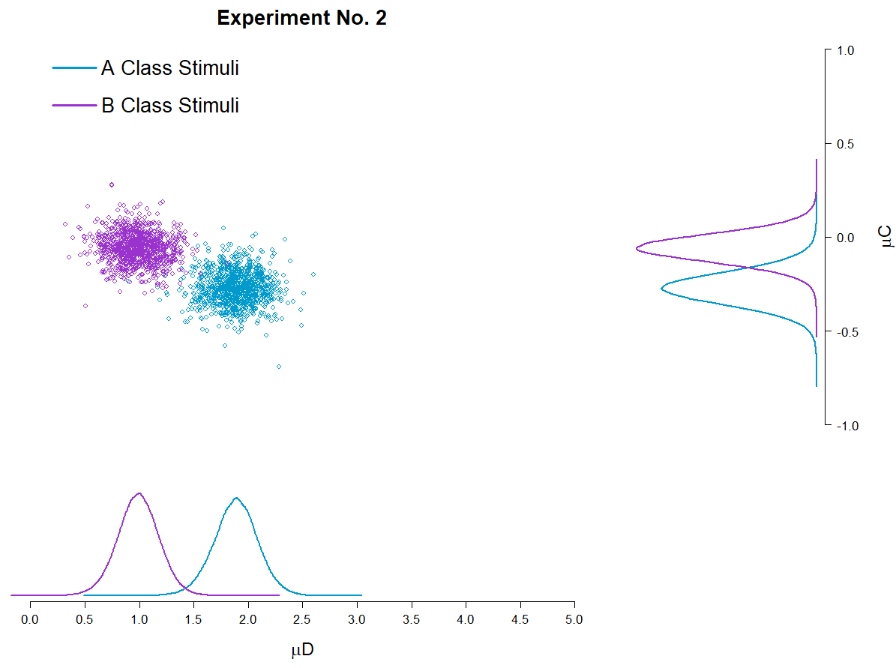

Slide 38
4. Step change point modeling
PENDING
Do participants face changes in D’ or C across trials?

Slide 39
5. Testing an Unequal Variance Model
PENDING
What can be inferred from the Confidence rating data?

Slide 40
5.1 Are participants using all of the Confidence Ratings ?
PENDING

